Slide 1
Online One Week Short Term Training Programme on Python Programming.
Prepared By,
A.Thomas Mary Sheeba,AP/IT

Slide 2
Contents
Lists
Tuples

Slide 3
LIST
Simplest Data Structure, used to store a list of values.
Ordered sequence of values of any data type(String, Float, Integer).
Values in the list are called elements/Items.
eg 1: mylist=[0,5,10,15,20]
eg 2: mylist1=[1,”IT”,12.5]
Items seperated by a comma.
Square Bracket is used to enclose the items.

Slide 4
Mutable and Indexed/Ordered.
Lists are "mutable" - we can change an element of a list using the index operator
eg:
>>> mylist=[1,2,3,4,5]
>>> mylist[0]=10
>>> print(mylist)
[10, 2, 3, 4, 5]

Slide 5
Accessing the elements in the list
The index starts at 0 and goes upto n-1, if there are n elements in the list.
Negative indexing can be done.
>>>mylist=[0,5,10,15,20]
>>> print (mylist[0])
0
>>> print (mylist[1])
5
>>> print (mylist[-1])
20

Slide 6
LISTS AND DEFINITE LOOPS
friends = ['Joseph', 'Mary', 'Sally']
for friend in friends:
print ("Happy New Year:",friend)
print ("Done!")
OUTPUT:
Happy New Year: Joseph
Happy New Year: Mary
Happy New Year: Sally
Done!

Slide 7
List Operations
Add two lists:
Repeat a list many times:
a = [1, 2, 3] print (a*3) [1, 2, 3, 1, 2, 3, 1, 2, 3]
a = [1, 2, 3] b = [4, 5, 6] c = a + b print( c) [1, 2, 3, 4 ,5, 6]

Slide 8
Exercise: Create a list of 5 zeros using zeros=[0].
>>> zeros = [0]*5
>>> print(zeros)
[0, 0, 0, 0, 0]

Slide 9
How Long is a List?
The len() function takes a list as a parameter and returns the number of elements in the list
Actually len() tells us the number of elements in the list.
>>> x = [ 1, 2, 'joe', 99]
>>> print (len(x))
4

Slide 10


Lists can be sliced
Slice extracts elements, based on a start and stop.
The slicing operator is COLON(:)
Syntax: listname[start:end-1]
>>> t = [9, 41, 12, 3, 74, 15]
>>> t[1:3]
[41,12]
>>> t[ :4]
[9, 41, 12, 3]
>>> t[3: ]
[3, 74, 15]
>>> t[ : ]
[9, 41, 12, 3, 74, 15]

Slide 11
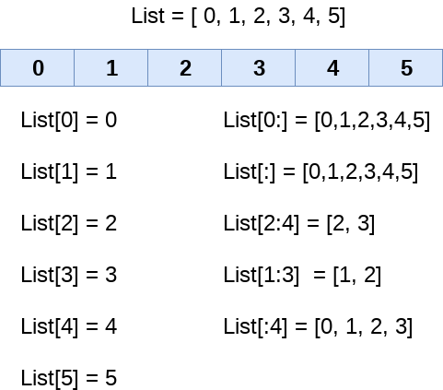
Example

Slide 12
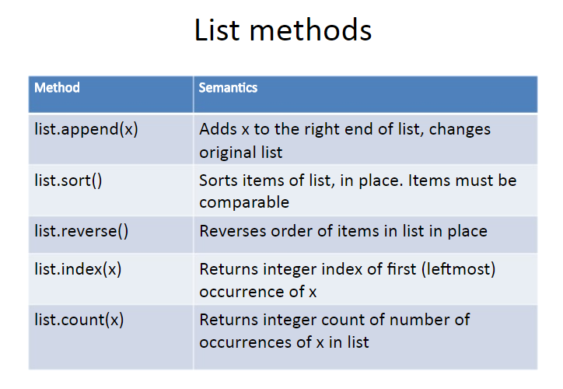

Slide 13
Append
Append is used to add an element into the list.
eg:>>> mylist=[1,2,3,4]
>>> print(mylist)
O/P:[1, 2, 3, 4]
>>> mylist.append(5)
>>> print(mylist)
O/P:[1, 2, 3, 4, 5]

Slide 14
Extend
Iterates over its argument and adding each element to the list and extending the list..
eg:>>> list1=[1,2,3,4]
>>> list2=[5,6,7]
>>> list1.extend(list2)
>>> print(list1)
O/P:[1, 2, 3, 4, 5,6,7]

Slide 15
Insert
Insert is used to insert an element on a desired position.
eg:>>> mylist=[1,2,3,4]
>>> print(mylist)
O/P:[1, 2, 3, 4]
>>> mylist.insert(2,10)
>>> print(mylist)
O/P:[1, 2, 10, 3, 4]

Slide 16
Sort
Sort is used to sort items of similar data types within the list.
It sorts the item either in ascending or descending order.
>>> mylist=[4,3,9,7,6,1,2]
>>> mylist.sort()
>>> print(mylist)
O/P:[1, 2, 3, 4, 6, 7, 9]
>>> mylist1=[1,'a',2.5]
>>> mylist1.sort()
Error message will be displayed.Since different data types.

Slide 17
Index
Index returns the integer index of the first occurrence of the item.
eg:>>> list2=['a','b','c',1,2,3]
>>> list2.index(2)
O/P:4
>>> list2.index('b')
O/P:1

Slide 18
Count
Count is used to count, how many times an object occurs in the original list.
eg:>>> mylist=['a','b','c','d','a','b','a']
>>> mylist.count('a')
O/P:3

Slide 19
Reverse
Reverse is used to arrange or view the items in reverse order.
eg:>>> list1=[1,2,3,4,5]
>>> list1.reverse()
>>> print(list1)
O/P:[5, 4, 3, 2, 1]
>>> list2=['a','b','c',1,2,3]
>>> list2.reverse()
>>> print(list2)
O/P:[3, 2, 1, 'c', 'b', 'a']

Slide 20
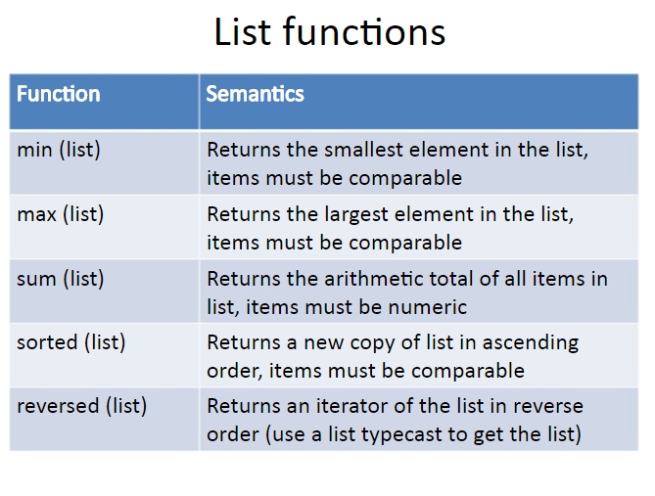

Slide 21
List Functions - Example
>>> mylist=[1,3,2,6,5,8,4]
>>> min(mylist)
1
>>> max(mylist)
8
>>> sum(mylist)
29
>>> sorted(mylist)
[1, 2, 3, 4, 5, 6, 8]
>>> mylist=[1,2,3,4]
>>> print(list(reversed(mylist)))
[4, 3, 2, 1]

Slide 22
Is Something in a List?
Python provides two operators that let you check if an item is in a list
These are logical operators that return True or False
They do not modify the list
>>> some = [1, 9, 21, 10, 16]
>>> 9 in some
True
>>> 15 in some
False
>>> 20 not in some
True

Slide 23
Deleting Elements from the List
There are several ways to delete elements from a list.
Pop():
If you know the index of the element you want, you can use pop.
Eg:>>> t = ['a', 'b', 'c']
>>> x = t.pop(1)
>>> print (t)
['a', 'c']
pop modifies the list and returns the element that was removed.
If you don't provide an index, it deletes and returns the last element.
Eg:>>> t = ['a', 'b', 'c']
>>> t.pop()
'c'

Slide 24
Del() method
2. Del():
If you don’t need the removed value, you can use del() operator.
>>> t = ['a', 'b', 'c']
>>> del t[1]
>>> print(t)
['a', 'c']

Slide 25
Remove() Method
3.Remove():
If you know the element you want to remove (but not the index), you can use remove.
>>> t = ['a', 'b', 'c']
>>> t.remove('b')
>>> print (t )
['a', 'c']

Slide 26
Clear() Method
4.clear():
This removes all the elements from the list.
>>> t = ['a', 'b', 'c']
>>> t.clear()
>>> print (t )
[ ]

Slide 27
copy() Method
5.copy():
This returns a shallow copy of a list.
>>> list1=[1,2,3]
>>> list2=list1.copy()
>>> print(list2)
[1, 2, 3]

Slide 28
List Aliasing
Aliaising happens whenever one variable’s value is assigned to another variable.
Two references are created to the same object.
Changes made with one list affects the other list.
Syntax : Newlist = Oldlist

Slide 29
Example for Aliasing
>>>list1=[25,10]
>>>list2=list1
list1
0 ->25
1->10
list2

Slide 30
CLONING
Cloning creates a copy of existing list.
Changes made in one list will not affect the other list.
Built-in function : list()
Syntax: newlist=list(oldlist)
newlist
oldlist

Slide 31
LIST COMPREHENSIONS
list comprehensions allow us to create new lists from lists.
Syntax : [expression for item in list]
Eg 1: [i*2 for i in [1,2,3,4]]
Output: [2,4,6,8]
Eg 2: [var**2 for var in range(1, 10)]
Output: [1, 4, 9, 16, 25, 36, 49, 64, 81]

Slide 32
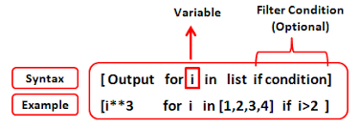
Conditionals in List Comprehension
for item in list:
if conditional:
expression

Slide 33
Example for List Comprehension
Eg: numbers = list(range(1,10))[1,2,3,4,5,6,7,8,9]
squares =[n*n for n in numbers]
odd_squares = [n*n for n in numbers if n%2==1]
print (numbers)
print (squares)
print (odd_squares)
[1, 2, 3, 4, 5, 6, 7, 8, 9]
[1, 4, 9, 16, 25, 36, 49, 64, 81]
[1, 9, 25, 49, 81]

Slide 34


Slide 35
Tuple
A tuple is a collection of elements which is ordered.
It is Immutable.
A tuple is created by placing all the items (elements) inside parentheses (), separated by commas.
Elements of different data type.

Slide 36
Creation of Tuple
# Empty tuple
my_tuple = ()
# Tuple having integers
my_tuple = (1, 2, 3)
# tuple with mixed data types
my_tuple = (1, "Hello", 3.4)
# nested tuple
my_tuple = ("mouse", [8, 4, 6], (1, 2, 3))

Slide 37
Tuples are IMMUTABLE
thistuple = ("apple","banana","cherry") thistuple[1] = "blackcurrant"
# test changeability print(thistuple)
TypeError: 'tuple' object does not support item assignment

Slide 38
Tuple Packing
A tuple can also be created without using parentheses. This is known as tuple packing.
Example:
>>>my_tuple = 3, 4.6, “cat"
>>>print(my_tuple)
# tuple unpacking is also possible
>>>a, b, c = my_tuple
>>>print(a) # 3 >>>print(b) # 4.6
>>>print(c) # cat

Slide 39
Accessing Tuple
1. Using Indexing
my_tuple = ('p','e','r','m','i','t')
print(my_tuple[0]) #Output 'p'
print(my_tuple[5]) # Output 't'
2. Negative Indexing
my_tuple = ('p', 'e', 'r', 'm', 'i', 't') print(my_tuple[-1]) # Output: 't'
print(my_tuple[-6]) # Output: 'p'
3. Slicing

Slide 40
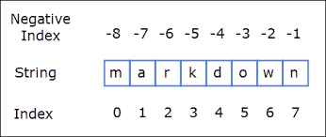
Negative Indexing
Access the tuples through negative indexing.
>>> tuple1=(‘m',‘a',‘r',‘k',‘d',‘o‘,’w’,’n’)
>>> tuple1[-1]
'n'
>>> tuple1[-2]
‘w'
>>> tuple1[-8]
‘m'

Slide 41
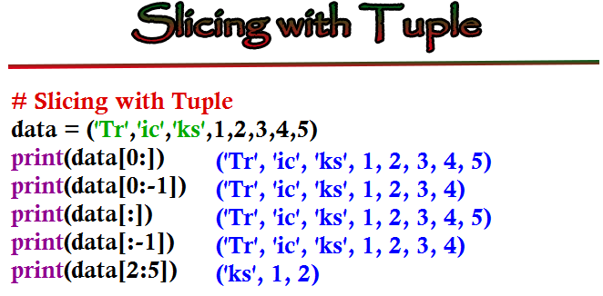

Slide 42
Operator
+ - Concatenation
* - Repetition

Slide 43
Built-in Functions with Tuple
Len()
Max()
Min()
Sum()
Sorted()
Eg: >>>tup1=(1,2,3,4,5)
>>> max(tup1)
5
>>> min(tup1)
1
>>> sum(tup1)
15
>>> len(tup1)
5
>>> tup1=(1,4,2,3,7,5)
>>> sorted(tup1)
[1, 2, 3, 4, 5, 7]

Slide 44
Tuple()
Converts iterables like string, list, dictionary, or set to a tuple.
Eg:
>>> mystring="hello world"
>>> tuple(mystring)
('h', 'e', 'l', 'l', 'o', ' ', 'w', 'o', 'r', 'l', 'd')
>>> mylist=['red','green','blue','violet']
>>> tuple(mylist)
('red', 'green', 'blue', 'violet')

Slide 45
Deleting a tuple
Deleting a tuple entirely, using the keyword del.
Example:
my_tuple = ('p', 'r', 'o', 'g', 'r', 'a', 'm', ‘m', ‘e‘, ’r’)
# can't delete items
# TypeError: 'tuple' object doesn't support item deletion # del my_tuple[3]
# Can delete an entire tuple
del my_tuple
# NameError: name 'my_tuple' is not defined print(my_tuple)

Slide 46
Advantages of Tuple over List
Tuples for heterogeneous (different) data types and lists for homogeneous (similar) data types.
Iterating through a tuple is faster than with list. So there is a slight performance boost.
Tuples that contain immutable elements can be used as a key for a dictionary. With lists, this is not possible.
If you have data that doesn't change, implementing it as tuple will guarantee that it remains write-protected.

Slide 47


Slide 48


